Slide 1

Task 11- Forces and Vehicle safety

Slide 2
Principal A- Increasing the time of the collision or the time the occupants take to stop
Car engineers have come together and worked their way out to try and finds ways to help reduce the harm caused towards car occupants by producing vehicles that crumple under impact. Crumple zones are commonly located in the front and rear of a vehicle and they are built into cars as a safety element. Automobiles are designed with crumple zones that are meant to collapse in the case of a collision. Crumple zones lessen the effect of an auto collision in two different ways, crumple zones also to decrease the influence of an auto collision. Crumpling decreases the possibility of the car rebounding after a collision, minimising the change in momentum and the impulse.

Slide 3
Principle B- spreading the forces of impact over the largest possible area& ensuring stability of the vehicle
~The physics theory that says it spreads the forces impact also applies to crumple zones. By doing this, some of the energy is absorbed and the impact is mitigated away from the car’s occupants
~the physics theory that says it spreads the forces impact also applies to crumple zones. By doing this, some of the energy is absorbed and impact is mitigated away from the car’s occupants. In other words, it is the area of the vehicle that contains all of its mass. In order to have a lower centre of gravity, modern cars are designed closer to the ground, which increases stability and improves handling.

Slide 4
Principle C- Minimizing contact of the person with the interior of the vehicle
-Automobile airbags are a safety element that aids in avoiding collisions with the car. The airbag is intended to inflate as soon as the automobile starts to slow down following a accident and deflate as son as your head touches it. This is essential because, in the absence of the airbag collapsing, your head would be defeated.
-Seatbelts are another safety measure that follows this rule. Seatbelts and airbags are designed to function together in contemporary vehicles. In a collision, the seatbelt slows down the moving passengers, allowing them to safely crash into the airbag. In a collision without a seatbelt, a passenger will keep moving forwards at the same speed as the vehicle until anything stops them.

Slide 5
Principle D- Keeping the person inside the vehicle
-Seatbelts retain the occupant within the car and take into account the law of inertia. By causing the occupant to decelerate the same pace as the vehicle in the case of a collision, a seatbelt reduces the likelihood of being propelled from the car. The transfer of energy is stopped by seatbelts
-Making sure the seatbelts are constantly securely fastened is crucial. In an accident, a seatbelt that isn’t securely fastened will allow the driver or passenger to slide forwards, increasing the risk that their heads will hit the dashboard.

Slide 6
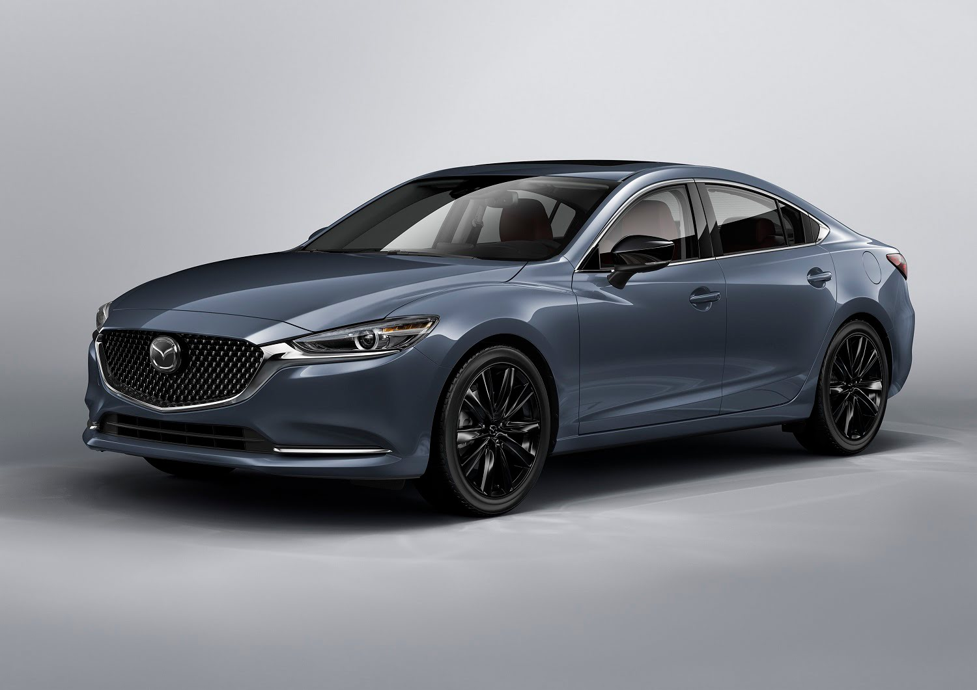
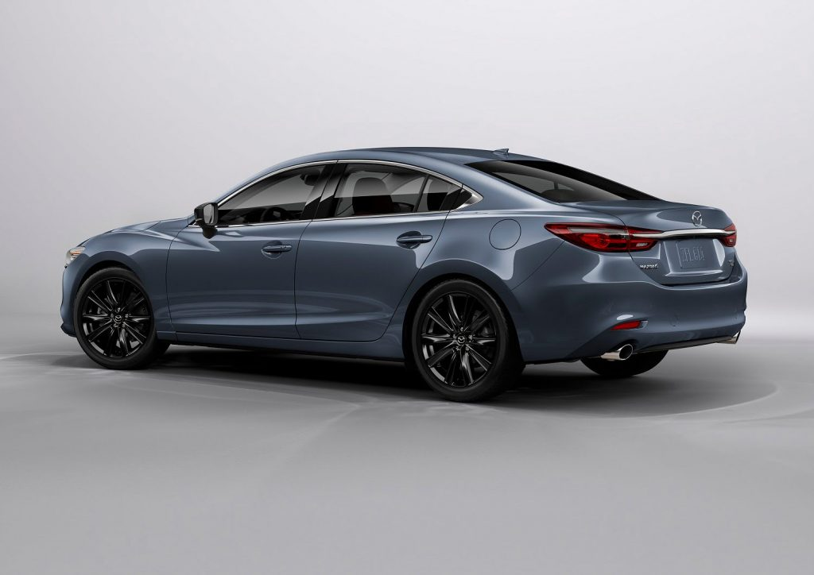
Safety features of a 2021 Mazda 6
Anti-lock brakes: When a tyre stops rotating while being subjected to intense braking, ABS (anti-lock braking system) brakes immediately detect the situation and adjust the brake pressure to restore tyre rotation. This improves the cars ability to brake and turn.
Stability Control: Stability control automatically detects when the vehicles handling limits have been surpassed and decreases engine power or applies certain brakes, in order to aid the driver avoid losing control of the vehicle.
Front-impact airbags: To protect the head in a frontal collision, drivers and passengers have front-impact airbags.
Side impact airbags: Front-seat sided impact airbags are intended to shield the torso from injury in a side impact crash.
Overhead airbags: Overhead airbags are employed to protect the heads of the occupants when a vehicle rolls over or is involved in a side collision.
Pretensioners: A pretensioner automatically tightens the seat belts in a crash to position the occupants in the optimal seating position.
Anti-whiplash: Anti-whiplash Headrests actively respond to the forces of rear impact collisions and wrap the occupants head to reduce the chance of whiplash
Security system: The car is fitted with an ignition disable device that will prevent the engine from starting if the proper original manufacture key is not used.

Slide 7
Mazda safety features linked to physis principle
~Principle A and B- Anti-lock brakes are a great set for when you are about to enter an accident. They are very helpful for speed control which can help slow down the car quicker then normal. Stability Control is also a great feature because it lengthens the braking distance and aids in collision warning. Additionally, it increases the vehicles stability and reflects some of the energy that would otherwise be delivered to the passengers
~principle c – Airbags: Im not 100% sure how many airbags are in a Mazda 6 all together but there is a dual frontal, side chest and side head airbag to aid in creating a barrier of protection around the internal area and avoid direct contact
~principle D – Seatbelts: The car has 5 seatbelts to keep the passenger/s and driver safe and secure

Slide 8
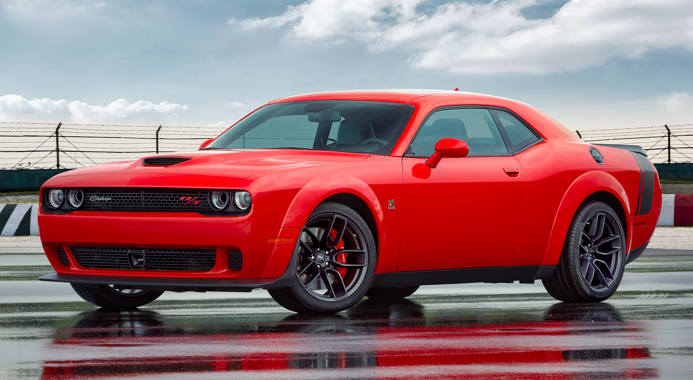
~The Dodge charger~
Based on the dodge Coronet, the first-generation Dodge charger was unveiled in 1966. Its large grill full-length centre console, and fastback roof are some of its most recognisable features. Although the dodge chargers were popular, their safety did not last a life time.
They are usually reliable for the first few years but after that it just goes downhill. One of the Dodge chargers safety feature was a front and rear crumple airbag system, this safety was designed to reduce the risk of injury in a collision. The dodger charger included advanced airbag system, surprisingly it had about seven airbags as they are used for direct protection to all seated passengers. The dodge charger

